Slide 1


Terapia farmacologica Controindicazioni assolute, controindicazioni relative ed eventi avversi
Angelo Iossa Md, Phd
Head of Bariatric Center of Excellence SICOB
Icot Hospital-Latina
Referral center SIUEC
Referral center ISHAWS

Slide 2
Conflict of interest
I’m Bariatric/Metabolic Surgeon

Slide 3
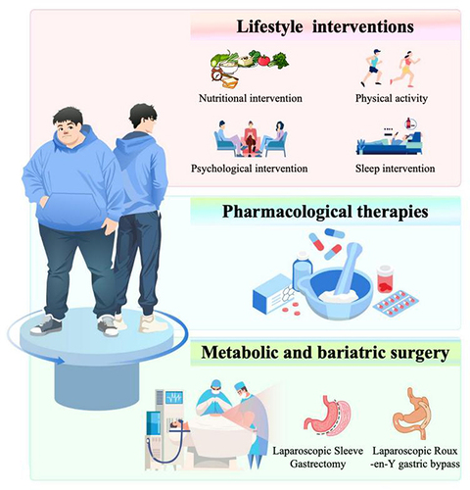
Why pharmacotherapy today?
• Chronic adiposity‑based disease
• BMI ≥30 or ≥27 with comorbidities
• Integrated care: lifestyle – drugs – bariatric surgery
• Disease‑modifying approach
Notes:
Emphasize paradigm shift.

Slide 4
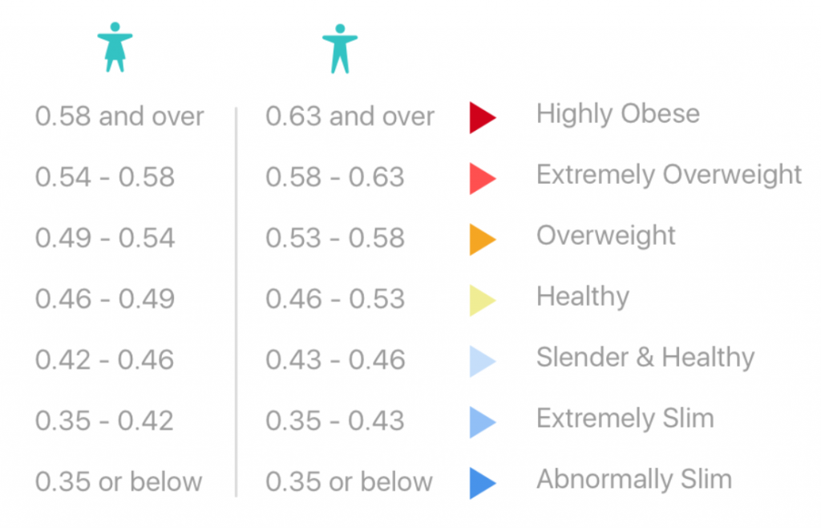
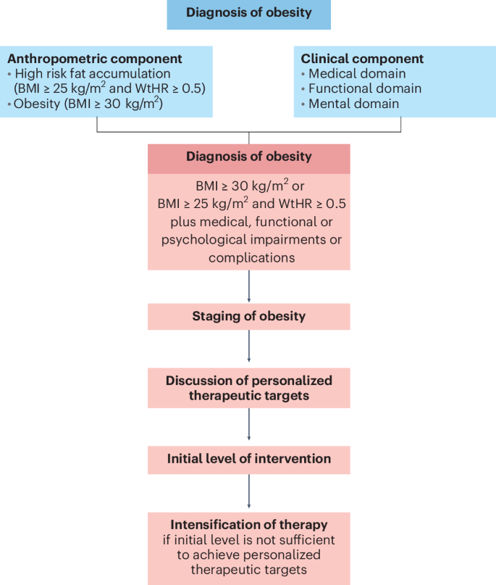

Un nuovo framework per la diagnosi, stadiazione e gestione dell’obesità negli adulti ¹
2024
L'obesità è una malattia multifattoriale, cronica, recidivante, caratterizzata da un accumulo anomalo e/o eccessivo di grasso corporeo, che rappresenta un rischio per la salute.¹
L'accumulo di grasso addominale è un importante fattore di rischio per il deterioramento della salute, anche in persone con basso BMI e ancora esenti da manifestazioni cliniche evidenti. ¹
L'uso di terapie farmacologiche dovrebbe essere considerato anche in presenza di BMI ≥25 kg/m² ed un rapporto vita-altezza > 0,5. ¹
La gestione deve andare oltre la semplice perdita di peso, includendo il trattamento delle complicanze legate all'obesità.¹
Obiettivo prioritario è la perdita di peso sostenibile nel tempo, per ridurre concretamente i rischi per la salute.¹
Fig 1 Rif 1
Rif: 1.Busetto L, A new framework for the diagnosis, staging and management of obesity in adults. Nat Med. 2024 Sep;30(9):2395-2399

Slide 5
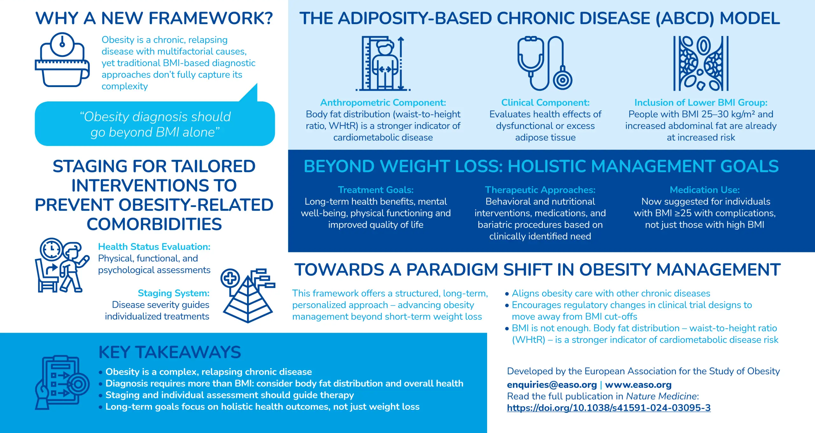
2024
Rif: EASO A new framework for the diagnosis, staging and management of obesity in adults 2024, A new framework for the diagnosis, staging and management of obesity in adults – EASO, ultimo accesso Aprile 2025,

Slide 6
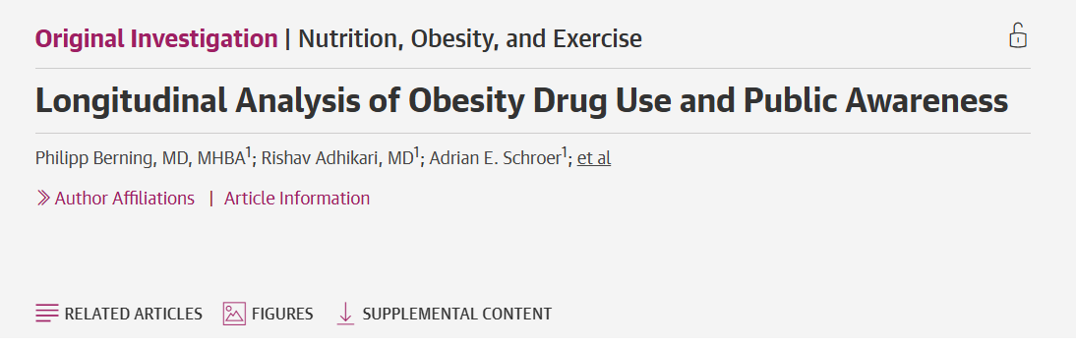
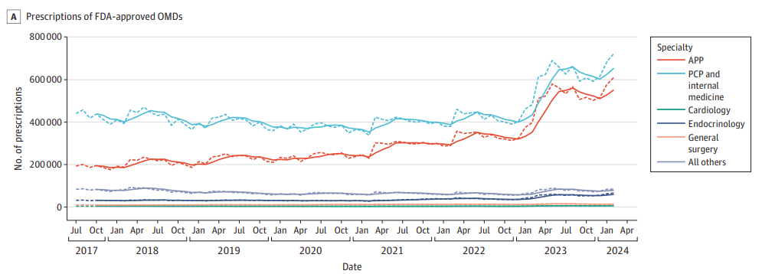
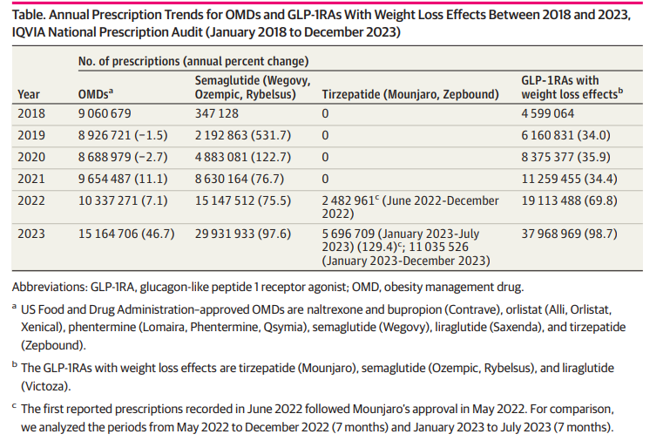
2025

Slide 7
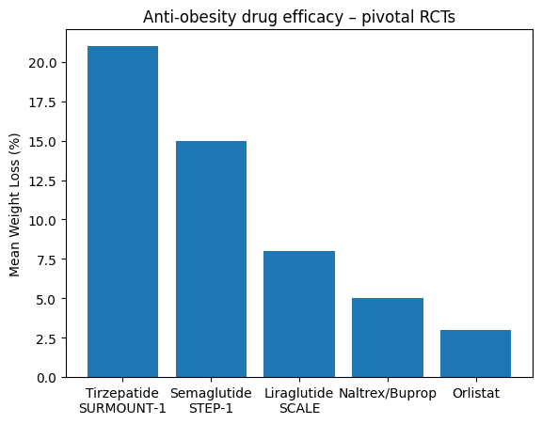
Weight‑loss efficacy (RCTs)
Notes:
SURMOUNT, STEP, SCALE trials.

Slide 8

Agenda
Absolute contraindications
Relative contraindications
Adverse events
Notes:
Introduce obesity as chronic relapsing disease.

Slide 9

Absolute contraindications
GLP-1 Agonists (e.g., Liraglutide, Semaglutide):
Personal or family history of medullary thyroid carcinoma (MTC).
Multiple Endocrine Neoplasia syndrome type 2 (MEN 2).
Pregnancy, lactation, or planning pregnancy.
Known hypersensitivity to the product.
Orlistat (Xenical/Alli)
Chronic malabsorption syndrome.
Cholestasis.
Pregnancy.
Notes:
MEN 2A (carcinoma midollare tiroideo, feocromocitoma, iperparatiroidismo) e MEN 2B (più aggressiva, con carcinoma midollare, feocromocitoma, neuromi mucosi e habitus marfanoide).

Slide 10
Absolute contraindications
Phentermine/Topiramate (Qsymia):
Pregnancy (highly teratogenic).
Uncontrolled high blood pressure (hypertension).
Cardiovascular disease (e.g., stroke, arrhythmia).
Hyperthyroidism.
Glaucoma.
Use of Monoamine Oxidase Inhibitors (MAOIs) within the last 14 days.
Naltrexone/Bupropion (Contrave):
Uncontrolled hypertension.
Seizure disorders.
Eating disorders (anorexia or bulimia nervosa).
Abrupt discontinuation of alcohol, benzodiazepines, barbiturates, or antiepileptic drugs.
Chronic opioid use.
Use of MAOIs.

Slide 11


Relative contraindications
GLP-1 Receptor Agonists (e.g., Semaglutide, Liraglutide):
History of pancreatitis or gallbladder disease.
Severe gastroparesis or other severe gastrointestinal motility disorders.
Moderate renal impairment (requires dose monitoring).
History of diabetic retinopathy (rapid weight loss can worsen it).
Orlistat:
Chronic malabsorption syndrome or cholestasis.
Notes:
Connect to bariatric experience.

Slide 12
Relative contraindications
Phentermine/Topiramate (Qsymia):
Controlled hypertension or stable cardiovascular disease.
Moderate-to-severe renal or hepatic impairment.
History of kidney stones or metabolic acidosis (due to topiramate).
Glaucoma.
Naltrexone/Bupropion (Contrave):
Controlled hypertension.
History of seizures or conditions increasing seizure risk (e.g., alcohol withdrawal).
Major depression or other psychiatric conditions (can cause mood changes).
General Clinical Considerations
Psychiatric: History of, or active, eating disorders (anorexia, bulimia) or suicidal ideation.
Cardiovascular: Stable cardiovascular disease or treated, stable hypertension.
Kidney/Liver: Renal or hepatic impairment requires dose reduction or avoidance depending on severity.

Slide 13

Relative contraindications
Notes:
Connect to bariatric experience.

Slide 14

Precise clinical history (personal, familiar)
Blood analysis
Nutritional/Psycological examination??

Slide 15
Agenda
Absolute contraindications
Relative contraindications
Adverse events
Notes:
Introduce obesity as chronic relapsing disease.

Slide 16
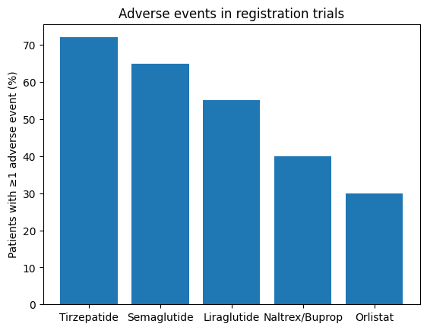
Adverse events frequency
Notes:
Mostly gastrointestinal.

Slide 17
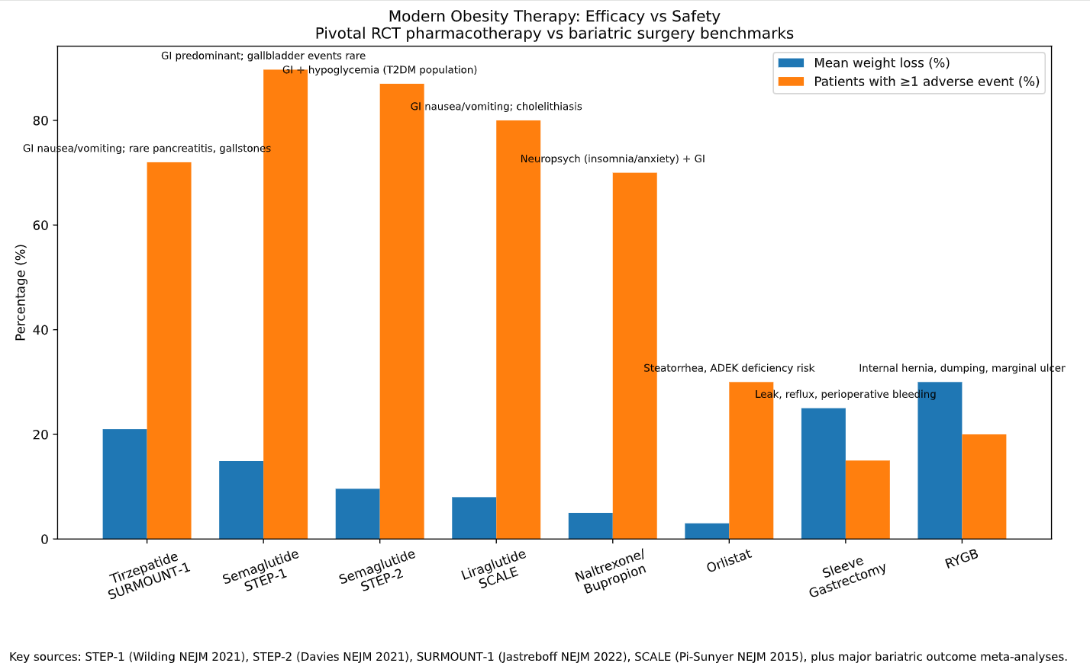

Slide 18
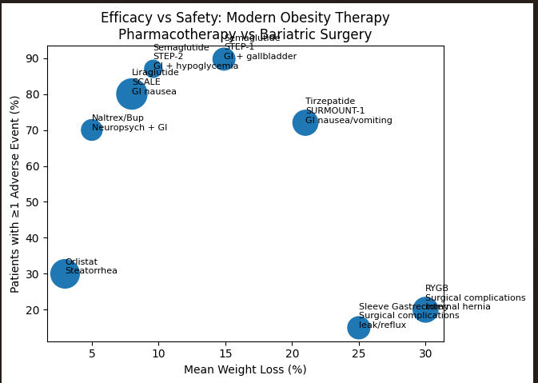

Slide 19
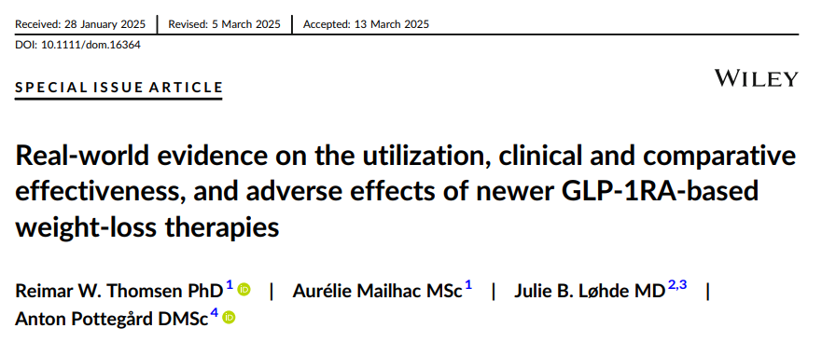
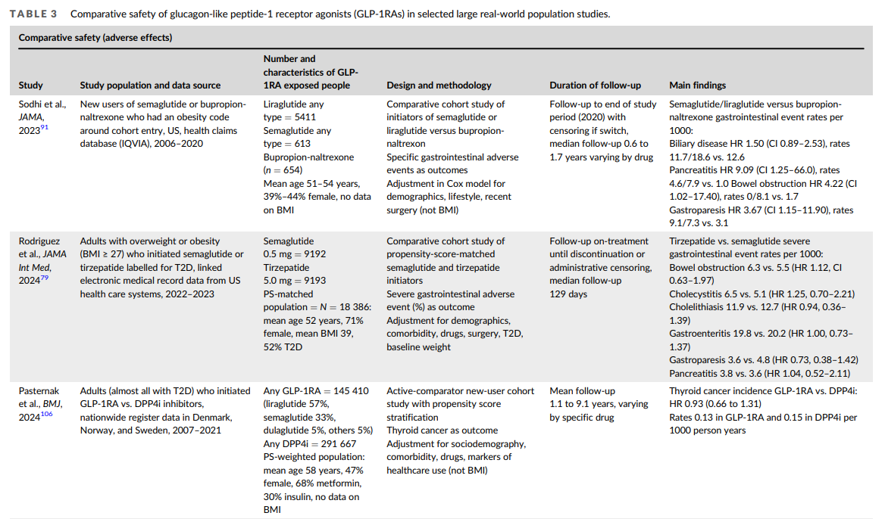
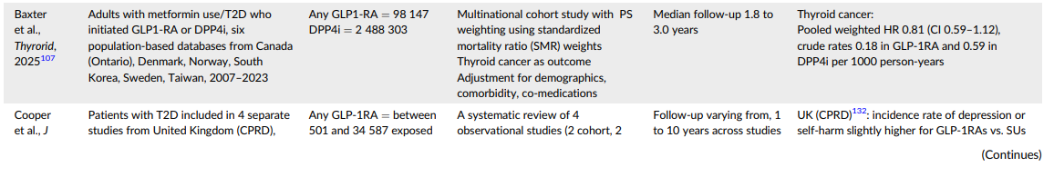
2025

Slide 20
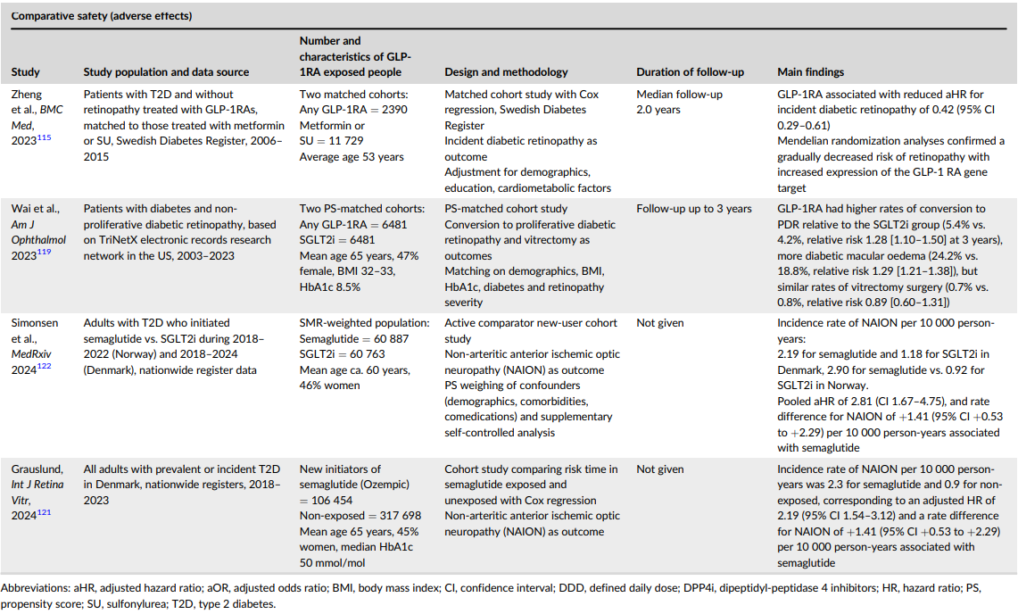
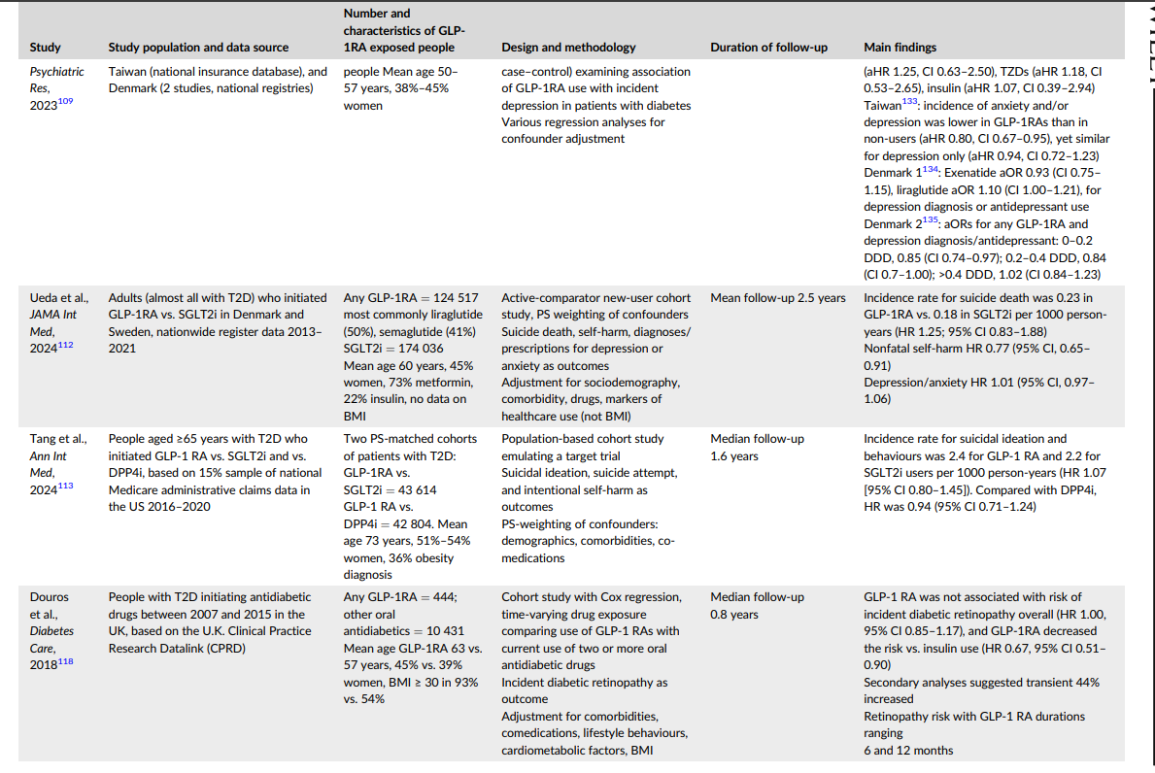

Slide 21

Selected adverse events of special interest STEP UP
AEs, n (%) | Semaglutide 7.2 mg (n=1004) | Semaglutide 2.4 mg (n=201) | Placebo (n=201)
Gastrointestinal AEs (OT) | 711 (70.8) | 123 (61.2) | 86 (42.8)
Dysaesthesia (OT) | 230 (22.9) | 12 (6.0) | 1 (0.5)
Cardiovascular disorders (OT) | 75 (7.5) | 22 (10.9) | 17 (8.5)
Psychiatric disorder AEs (OT) | 69 (6.9) | 16 (8.0) | 15 (7.5)
Neoplasms (IT) | 56 (5.6) | 11 (5.5) | 10 (5.0)
Gallbladder-related disorders (OT) | 29 (2.9) | 6 (3.0) | 1 (0.5)
Hepatic disorders (OT) | 26 (2.6) | 6 (3.0) | 2 (1.0)
Injection-site reactions (OT) | 25 (2.5) | 2 (1.0) | 3 (1.5)
Acute pancreatitis (OT) | 3 (0.3) | 0 | 0
Hypoglycaemia (OT) | 3 (0.3) | 2 (1.0) | 0
Data are on-treatment or in-trial observation period. AE, adverse event; GI, gastrointestinal; IT, in-trial; OT, on-treatment. Wharton S et al. Lancet Diabetes Endocrinol 2025; DOI: 10.1016/S2213-8587(25)00226-8.

Slide 22
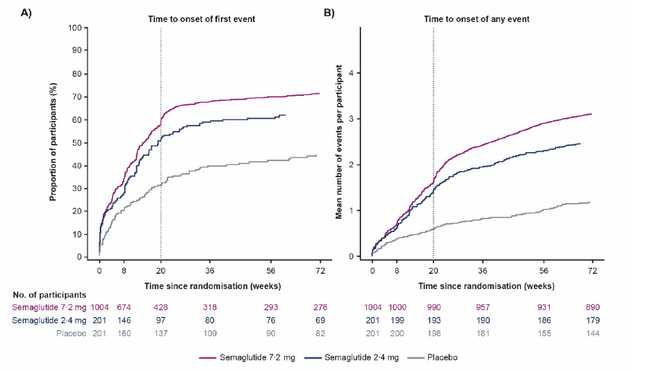
Gastrointestinal adverse events STEP UP
100
Time to onset of the first event
End of dose escalation
GI AEs, n (%) | Semaglutide 7.2 mg (n=1004) | Semaglutide 2.4 mg (n=201) | Placebo (n=201)
All GI AEs | 711 (70.8) | 123 (61.2) | 86 (42.8)
Serious GI AEs | 11 (1.1) | 1 (0.5) | 3 (1.5)
GI AEs leading to permanent discontinuation | 33 (3.3) | 4 (2.0) | 0
GI AEs by preferred term
Nausea | 439 (43.7) | 77 (38.3) | 26 (12.9)
Diarrhoea | 272 (27.1) | 56 (27.9) | 26 (12.9)
Vomiting | 249 (24.8) | 33 (16.4) | 14 (17.0)
Constipation | 233 (23.2) | 39 (19.4) | 18 (9.0)
90
80
70
60
50
Cumulative proportion of participants (%)
40
30
20
10
0
0
8
20
36
56
72
Time since randomisation (weeks)
Semaglutide 7.2 mg
Semaglutide 2.4 mg
Placebo
Left panel shows the cumulative incidence (time to first event) of events. The grey line at week 20 indicates the last stage of dose escalation (from 2.4 mg to 7.2 mg) for participants receiving semaglutide 7.2 mg. Data are for the safety analysis set and are from the on-treatment observation period. observation period. AE, adverse event; GI, gastrointestinal. Wharton S et al. Lancet Diabetes Endocrinol 2025; DOI: 10.1016/S2213-8587(25)00226-8.

Slide 23

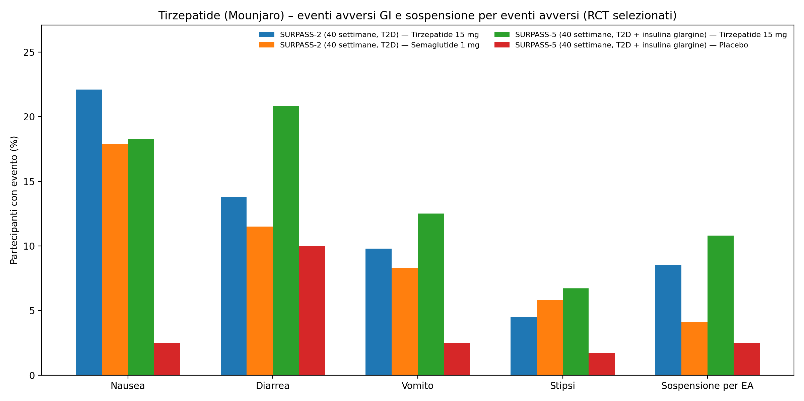

Slide 24
Frequent adverse events
Serious adverse events
• Nausea, vomiting, diarrhea
• Abdominal pain
• Gallstones risk
• Appetite suppression
• Pancreatitis
• Severe gastroparesis
• Bowel obstruction (rare)
• Aspiration risk perioperatively
Notes:
Counsel patients.

Slide 25

Take‑home messages
• Pharmacotherapy central in obesity care
• Safety profile favourable but patient selection crucial
• Needs adequate competence and side effects identification and tretment
Notes:
Strong closing.

Slide 26


Grazie
Angelo.iossa@GMAIL.it
@angeloiossmd

